Slide 1
Cricket Match Prediction and Analysis (T20,IPL)
Maliha Tasnim Aurini(14101051) – Coding AND Environment Setup
Shitab Mushfiq-Ul Islam(14101088) – Data Analysis and Presentation Making
Fahima Akter (14301015) – Result analysis and report writing

Slide 2
Problem Statement
The problem statement is to predict the outcome of a T20 match (i.e IPL match).
We would be taking as input,
Opposition team
Venue
City
Toss Winner
Toss Decision
Given above inputs, our target is to predict which team will emerge as a winner

Slide 3
Working Area
Area of work Predictions
Covered area Prediction of Cricket match

Slide 4
Motivation
Predicting the outcome of a match before starting of the match
Screening various kind of prediction statistics
Which match is more important
What factors can be involved on winning a match

Slide 5
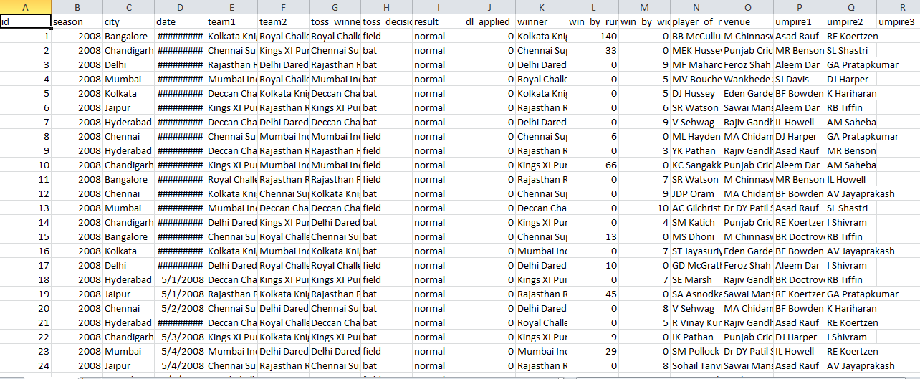
Data Collection(Snap Shot)

Slide 6
Data Collection
City - In which city the match is played
Team 1 and Team 2 – participating team name
Toss winners – Name of the team
Toss decision – Bating or Fielding
Winners (Testing purpose)- Name of the team
Runs - won by how many runs
Wickets – Won by how many wickets
Venue - Name of the stadium
Umpires – 1st , 2nd and 3rd umpires name
NaN Values - NaN values in winner column, so that we can
update it as draw

Slide 7
Data Collection
Dataset was collected from website www.kraggle.com
Match-wise performance of all the team
March-wise performance of opposition team
Venue of each match
Day-Day/Night
Toss
Toss win or Toss loose
Out Comes Predicting match win or loose based on toss win
Predicting match win depending on venue and field

Slide 8
Techniques/Approaches
Available Algorithms - K-nearest neighbors
Naive Bayes
Support Vector Machines
Logistic regression
Implemented Algorithms – Logistic Regression
Random Forest Classifier
Decision Tree Classifier
Random Forest Regression

Slide 9
Codes and Library
Resources available – BigData made simple,
machinelearningmistry.com
Github
Background study - Crickinfo
kraggle dataset

Slide 10
Program Overview
Input data
Chart presentation
Removing NaN values
Prediction
Testing Data
Encoding data
Implementing Algorithms
Train dataset

Slide 11
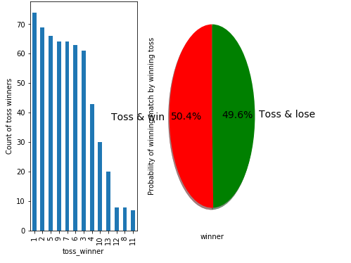
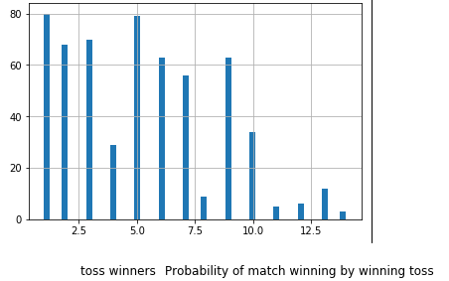
Results
Figure no. 2
Figure no. 3

Slide 12
Conclusion
Improve and makes the algorithm efficient
Include player performance to predict the match
Publishing paper in future

Slide 13
References
“Predicting Fantasy Football - Truth in Data”, Matt Bookman,December 14, 2012
“Predictions and Rankings in College Football”,Dennis Qin,10th December 2009
“Predicting Fantasy Football Performance with Machine Learning Techniques”, Nitin Kapania
K.-Y. Huang and W.-L. Chang, “A neural network method for prediction of 2006 world cup football game,” in Neural Networks (IJCNN), The 2010 InternationalJoint Conference on, July 2010,pp. 1 –8.
R.-K. Balla, “Soccer match result prediction using neural networks,” Aug 2007.
“CricAI: A Classification Based Tool to Predict the Outcome in ODI Cricket”,Amal Kaluarachchi, Aparna S. Varde,Department of Computer Science,Montclair State University, Montclair, NJ, USA
A. Joseph, N. E. Fenton, and M. Neil, “Predicting football resultsusing bayesian nets and other machine learning techniques,” Know.-Based Syst., vol. 19, pp. 544–553, November 2006. [Online]. Available:http://dl.acm.org/citation.cfm?id=1222216.1222263
“A Neural Network Method for Prediction of 2006 World Cup,Football Game”,Kou-Yuan Huang, Senior Member, IEEE and Wen-Lung Chang
J. Hucaljuk and A. Rakipovic, “Predicting football scores using machine learning techniques,” in MIPRO, 2011 Proceedings of the 34th International Convention,May 2011, pp. 1623–1627.
A. Joseph, N. E. Fenton, and M. Neil, “Predicting football results using bayesian nets and other machine learning techniques,” 2005.[Online].Available: http://www.dcs.qmw.ac.uk/norman/papers/Spurs-2.pdf

